Slide 1



Introduction to Book Building and Reverse Book Building
Book building and reverse book building are essential processes in capital markets. They play a crucial role in determining the price and demand for new securities.
AM
by Anoop Mohanty

Slide 2
Definition of Book Building
Book building is a process used to determine the optimal price for a new security offering. This involves gathering indications of interest from potential investors.
Process
Objective
The process involves gathering orders from potential investors at different price points.
The objective is to gauge the demand for the securities and find a fair and attractive price for both the issuer and investors.

Slide 3

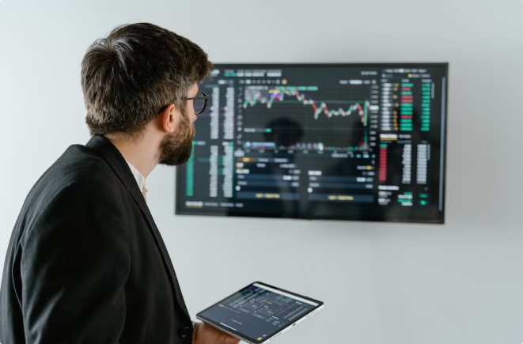
Key steps in Book Building process
1
Pre-Marketing
Preliminary discussions with potential investors to gauge interest and gather feedback.
2
Order Book Formation
Gathering orders from investors at different price points.
3
Pricing
Setting the final offering price based on the demand received.
4
Allocation
Distributing the securities to investors based on their orders.

Slide 4

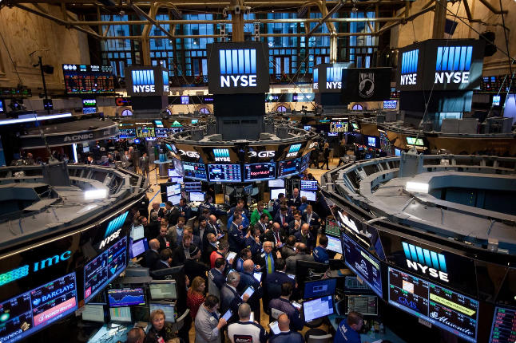
Advantages of Book Building
1
Price Discovery
2
Efficient Allocation
Helps determine a fair price for the security based on market demand.
Ensures that the securities are allocated to the most interested investors.
3
Enhanced Transparency
4
Reduced Risk
Minimizes the risk of under or over-subscription for the issuer.
Provides a transparent process for setting the offering price and allocating shares.

Slide 5
Definition of Reverse Book Building
Reverse book building is a process used to determine the optimal price for a buyback or tender offer.
Process
Objective
The issuer gathers indications of interest from shareholders at different prices.
The objective is to determine the optimal price at which the issuer can buy back shares.

Slide 6


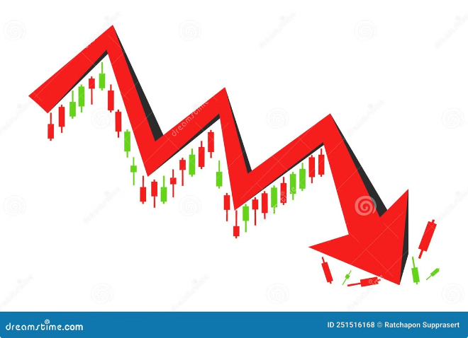



Key steps in Reverse Book Building process
Announcement
The issuer announces its intention to buy back shares and sets a preliminary price range.
Tender Period
Shareholders are given a period to submit their offers to sell shares at specific prices.
Final Price Determination
The issuer determines the final buyback price based on the offers received.
Acceptance & Payment
The issuer accepts offers at or below the final buyback price and pays the shareholders.

Slide 7

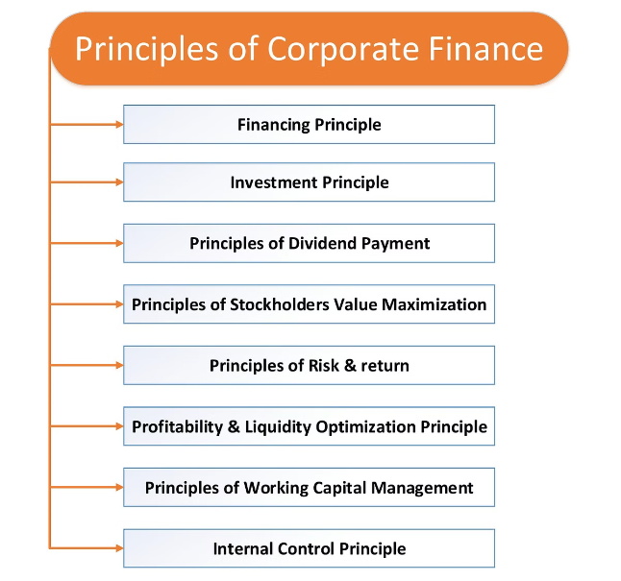
Advantages of Reverse Book Building
Fair Price Determination
Increased Shareholder Engagement
Ensures that the buyback price is based on the market's perception of the company's value.
Allows shareholders to actively participate in the buyback process and receive a fair price for their shares.
Optimized Capital Allocation
Helps the issuer allocate capital efficiently by purchasing shares at the most favorable price.

Slide 8


Differences between Book Building and Reverse Book Building
Feature
Book Building
Reverse Book Building
Purpose
Determine the offering price for new securities
Determine the buyback price for existing shares
Process
Gathering orders from potential investors
Gathering offers from existing shareholders
Outcome
Setting the offering price and allocating shares
Determining the buyback price and accepting offers

Slide 9




Scenarios where each method is more suitable
Book Building
Reverse Book Building
Suitable for initial public offerings (IPOs), follow-on offerings, and rights issues.
Suitable for share buybacks, tender offers, and mergers and acquisitions.

Slide 10


Conclusion and summary
Both book building and reverse book building are crucial tools for efficient capital markets. These processes help to ensure fair price discovery and optimal allocation of capital.

